Slide 1
WEEK 4 — RECAP SESSION
The three things you asked to go over again
Gene duplication · Generalised (weighted) parsimony · Rooting the tree of life
Follows the week 4 lecture. Figures redrawn from the lecture slides.
Notes:
Say at the start that these three came from their own questions, and that all three turn out to be the same story: a duplication is raw material, a trap, and a tool. That sentence is the spine of the whole session.

Slide 2
PART ONE
Gene duplication: where the copies come from, and what becomes of them
Two ways a second copy appears, then the four fates it can meet — and finally why any of this belongs in a week about building trees.
Notes:
Three questions to keep on the board: how does a second copy appear? what does selection do with it once there are two? and what does it do to a phylogeny? The third one is the bridge to the rest of the session.

Slide 3
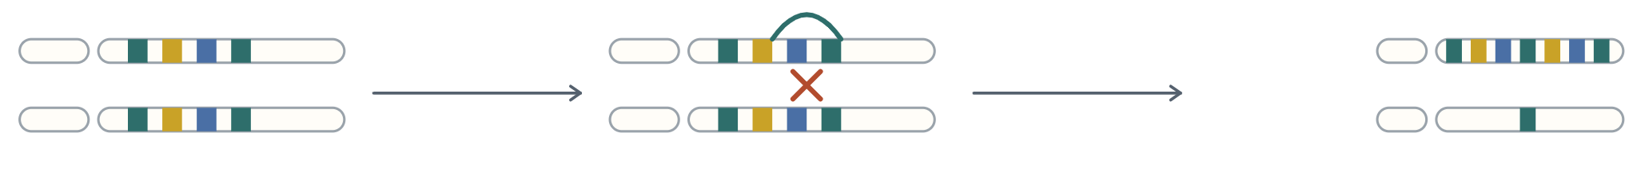
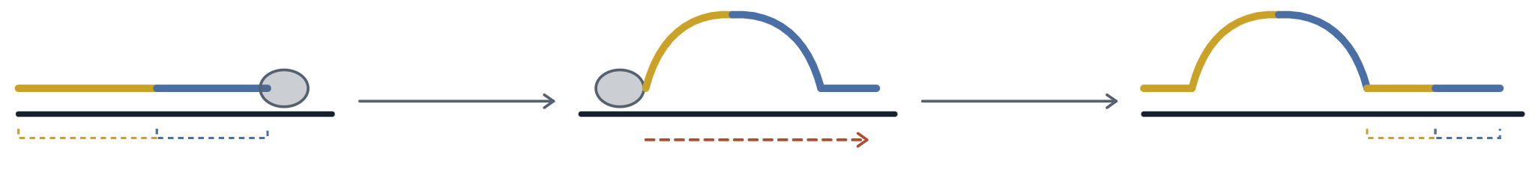
Two accidents that hand you a second copy
a — Ectopic recombination
the repeats misalign
crossover between them
duplication
deletion
The flanking repeats let the two chromosomes pair out of register, and a crossover between mismatched repeats gives one product a second copy of both genes while the other is stripped bare. Teal = repeat, gold = gene A, blue = gene B.
b — Replication slippage
slippage and looping
polymerisation resumes
gene A
gene B
gene A
gene B
The new strand comes loose, loops out and re-anneals further back along the template (black), so the polymerase reads the same stretch twice. The daughter molecule leaves with two copies of each gene — one in the loop, one on the strand.
Notes:
Both panels are the same story told at two scales: repeated sequence lets the machinery lose its place. Ectopic recombination loses its place between two chromosomes, slippage loses it within one strand. The self-reinforcing part is worth saying out loud - repeats cause both accidents, and both accidents make more repeats, so once an array exists it keeps growing and shrinking. That is the situation in the rDNA and olfactory receptor families later in this part. Also note the asymmetry in panel a: every duplication comes with a deletion in the sister product, so the two are always produced together.

Slide 4


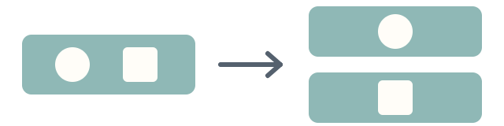

THE FOUR FATES
Once there are two copies, selection only needs one of them
Nonfunctionalisation
Conservation
Subfunctionalisation
Neofunctionalisation
One copy picks up a stop codon or a frameshift and dies. By far the commonest outcome.
Both copies are kept because more product is better. Dosage selection holds them identical.
The ancestor did two jobs; each copy loses one. Both are now needed to do what one gene did.
The spare copy is free to change and lands on something genuinely new. Rare, and the reason gene families exist.
For example, about half of our olfactory receptor genes are dead.
For example, rRNA genes sit in arrays of hundreds of near-identical copies.
For example, a gene used in two tissues; each copy keeps one of them.
For example, our red and green opsins, and three-colour vision.
Colour follows the lecture figure: teal = original function, pale teal = partial loss, dashed = dead, orange = new function.
Notes:
The unifying logic: duplication removes the constraint. With one copy, every change is tested against the job the gene already does; with two, one of them is invisible to selection for a while. What differs between the four fates is only what happens during that window of freedom - and the window is short, because loss-of-function mutations are much more common than improvements. That is why nonfunctionalisation is the default and neofunctionalisation is the exception worth writing papers about. The opsin example on the right is the one from the lecture: the M gene duplicated and gave M and L, which is where Old World monkey trichromacy comes from.

Slide 5
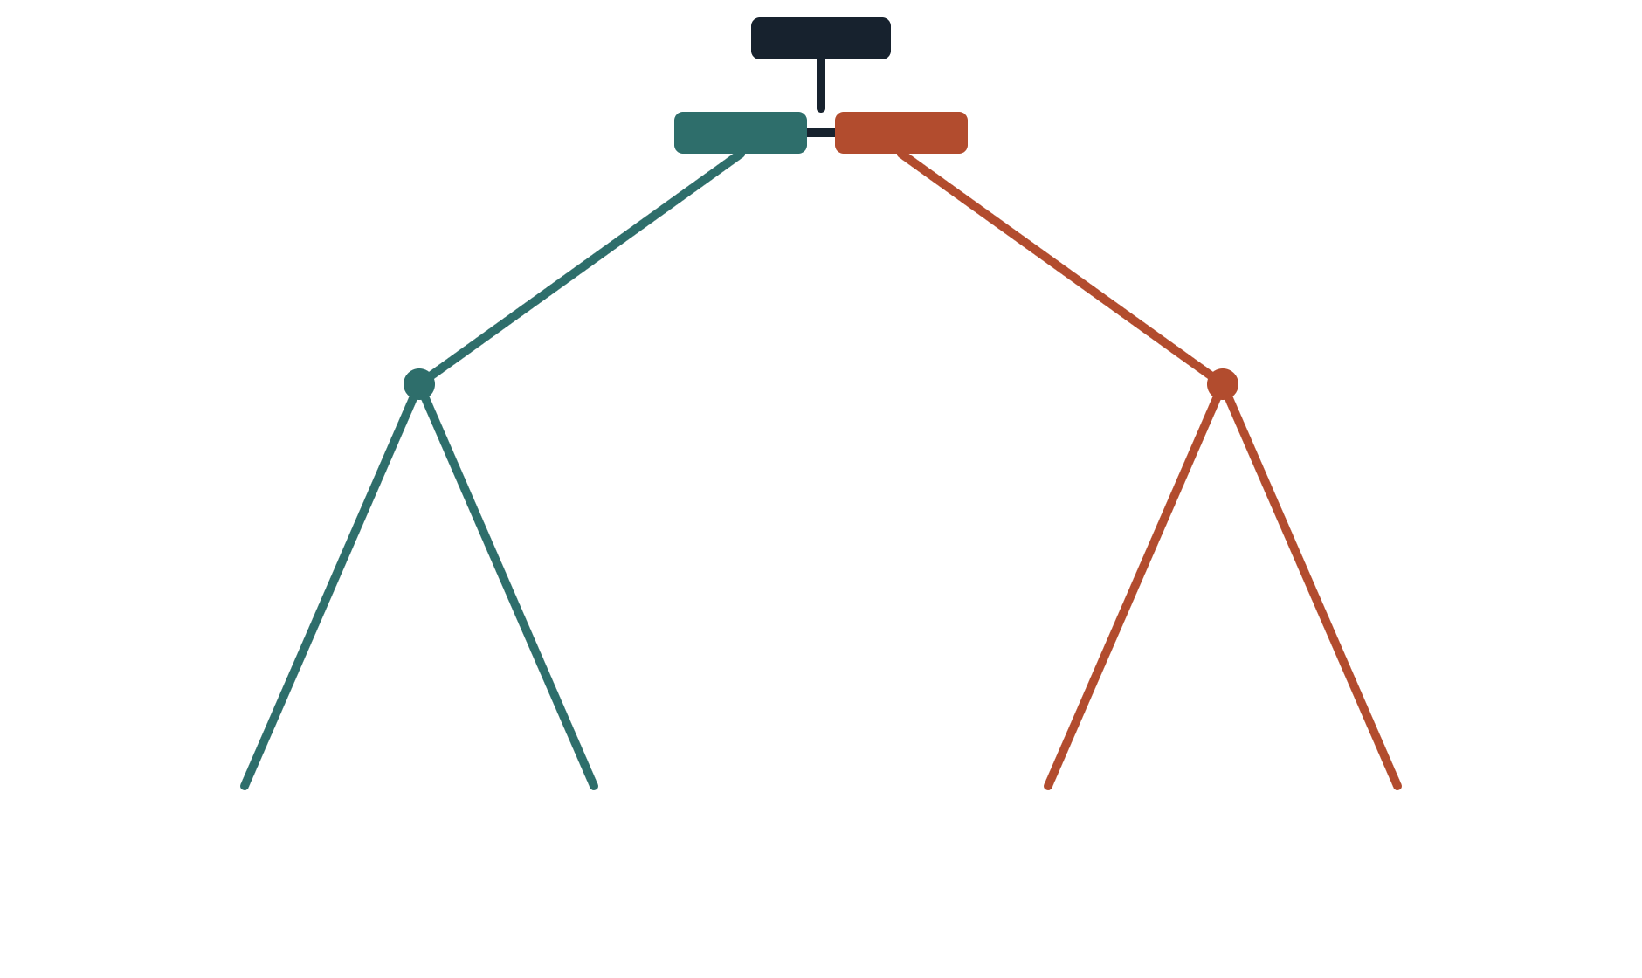
WHY A TREE PERSON CARES
Orthologs, paralogs, and which pair dates what
gene X
Orthologs — Y1 and Y2
the duplication: one gene becomes two
Separated by the speciation. Their divergence dates the split between the two species. These are the sequences you want in a species tree.
speciation
speciation
Paralogs — Y1 and Z1
Separated by the duplication at the top of the tree, which is older. Their divergence dates that event — and both live in the same genome, so no speciation is involved at all.
Y1
Y2
Z1
Z2
species 1
species 2
species 1
species 2
Put Y1 and Z2 in an alignment and call it a species comparison and the tree is not wrong — it is answering a different question. A BLAST best hit is not automatically an ortholog.
Notes:
Point at the two boxes at the top before anything else: one gene, one genome, becoming two genes in the same genome. No species has split yet at that moment. Then the gene tree is always a correct history of the genes; the error is in reading it as a history of the species. Worth saying out loud: if you sample Y from human and Z from mouse, the node you date is the duplication, and you will conclude humans and mice split hundreds of millions of years earlier than they did. Also flag the direction this points: the duplication node is older than every speciation below it, which is the hinge of part three.

Slide 6

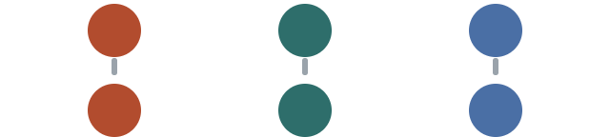

Three ways a gene family can evolve
Divergent
Concerted
Birth-and-death
ancestor
ancestor
ancestor
species 1
species 1
species 1
species 2
species 2
species 2
Each member keeps its own identity, so members pair up across species as orthologs.
Gene conversion keeps copies identical within a species while the species drift apart.
New copies are born and old ones die, so family size differs between species.
For example, olfactory receptors: the count differs by hundreds between mammals, and many are dead.
For example, the globins: alpha, beta and myoglobin each keep their own job in every species.
For example, the rRNA arrays, where neighbours resemble each other more than their orthologs.
Notes:
Ask which of the three would wreck a phylogeny most quietly. Concerted evolution is the dangerous one: the copies within a species look like each other rather than like their true orthologs, so a tree built from them recovers the species tree by accident and the duplication looks far younger than it is. Come back to this in part three - the EF-Tu / EF-G rooting only works because those two paralogues have never been homogenised.

Slide 7
THE CONNECTION TO THIS WEEK
Three ways a duplication shows up in your tree
1
A gene tree is not a species tree
Sample one paralog from one species and a different paralog from another and your deepest node is a duplication, not a speciation. Every downstream date is inflated. The tree itself is perfectly correct — it is the label on the node that is wrong.
2
A dead copy breaks the clock
Nonfunctionalisation is a rate change on one branch. That is exactly what the relative-rate and Tajima tests are built to detect, and exactly what makes a dated tree wrong if you ignore it. A long branch is also the setup for long-branch attraction.
3
A duplication is an outgroup you can use
If the duplication is older than every speciation in your group, then each copy is an outgroup for the other — and you did not have to find an organism outside the group. Hold on to this one; it is the whole of part three.
Notes:
Points 1 and 2 are the warnings, point 3 is the payoff. Do not rush point 3: it is counter-intuitive that you can root a tree using a gene from inside the group. The trick is that the duplication node is outside the group in time even though the sequences are inside it in space.

Slide 8
PART TWO
Parsimony, and what changes when you start weighting the steps
We will score one small alignment by hand twice — once counting every change as one step, once with a cost matrix — and then ask how that differs from using a substitution model.
Notes:
The alignment on the next slide is the one from the lecture figure, so they should recognise it. Doing it by hand is the point: once they have counted steps themselves, the words "tree length" and "optimality criterion" stop being abstract.

Slide 9
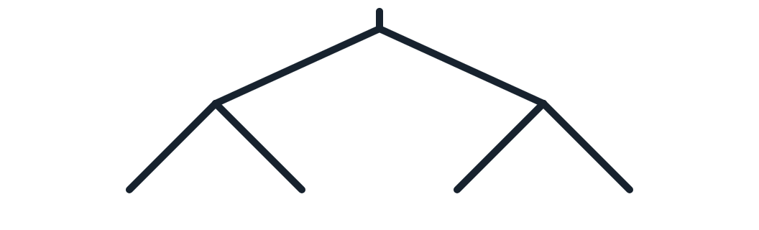
Most sites in an alignment cannot help you choose a tree
site | 1 | 2 | 3 | 4 | 5 | 6 | 7
I | A | G | G | G | G | G | T
II | G | G | G | A | G | G | G
III | G | A | G | G | A | A | T
IV | G | G | A | G | A | A | G
use? | no | no | no | no | yes | yes | yes
A site is parsimony-informative when at least two different bases each appear in at least two taxa.
Sites 1 to 4 have one odd taxon out: one change wherever you hang it, so they cost all three trees the same and cannot vote. Sites 5 to 7 split the four taxa 2 against 2, and only then does the grouping change the count.
Tree A — (I,II)(III,IV)
Tree B — (I,III)(II,IV)
Tree C — (I,IV)(II,III)
I
II
III
IV
I
III
II
IV
I
IV
II
III
Notes:
These three are the only unrooted topologies four taxa can make, and they are what Tree A, B and C mean for the rest of this part. Show on the drawings why a singleton site cannot choose: put taxon I's odd base on any of the three and it is still one change on the branch leading to I. Then put sites 5 to 7 on them and the counts separate. Worth stating plainly: a 1000 bp alignment of close relatives may contain twenty informative sites, which is why parsimony analyses can flip on a handful of positions.

Slide 10
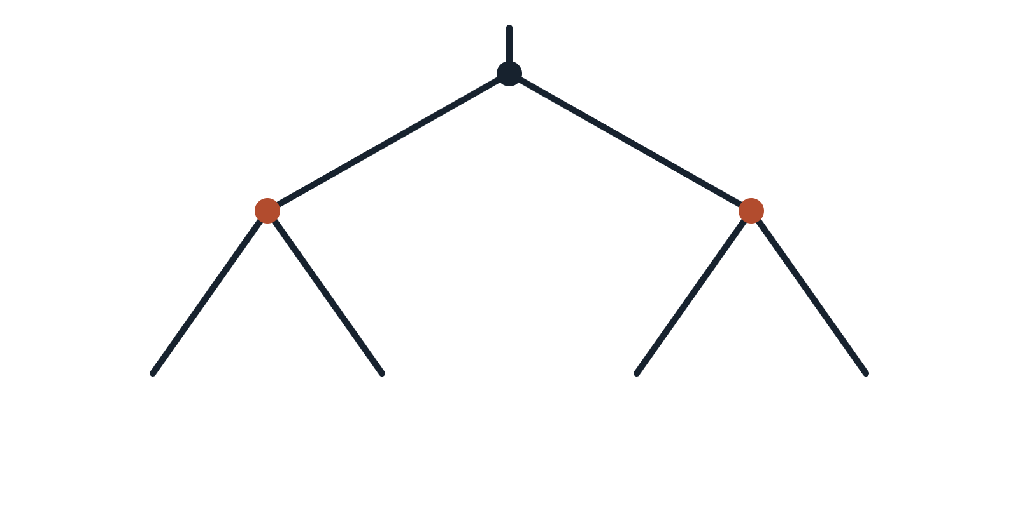
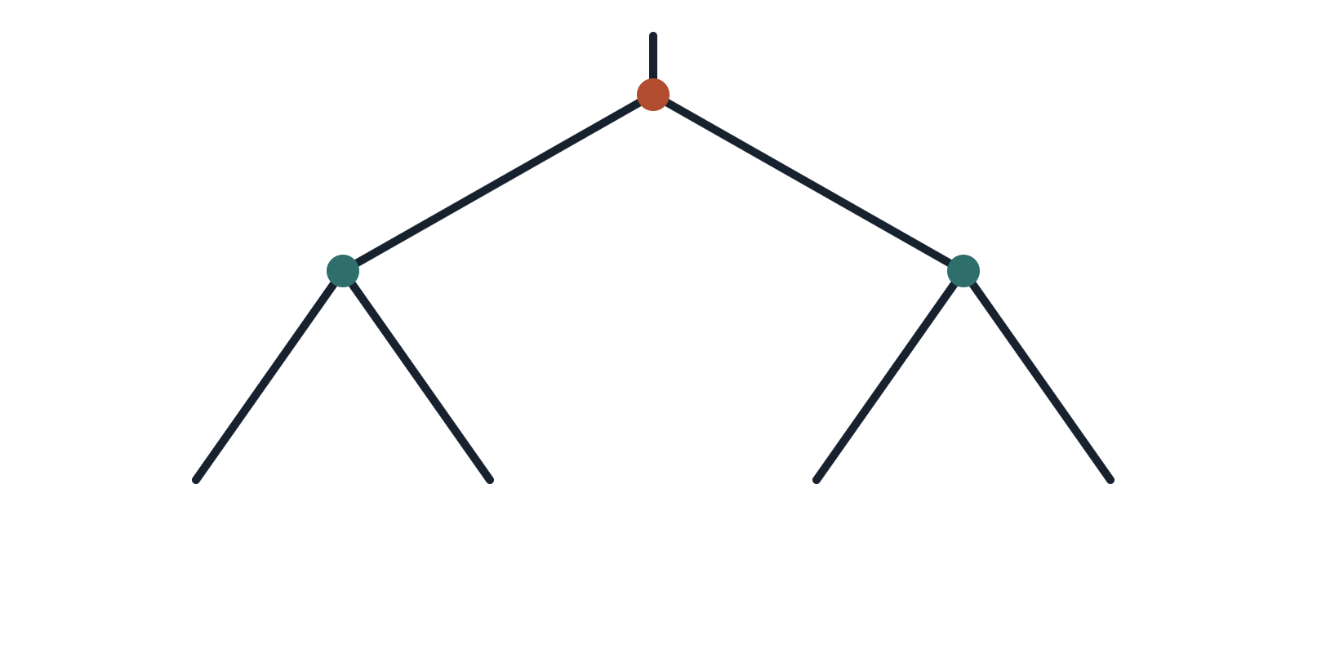
Scoring one site: intersect, and if it is empty, pay a step
Site 7, pattern T G T G. At every internal node take the intersection of its two children's sets. Empty? Take the union instead and add one step. Each node below is labelled with the set it ends up carrying.
{T,G}
{T,G}
{T,G}
{T,G}
{T}
{G}
I
II
III
IV
I
III
II
IV
T
G
T
G
T
T
G
G
Tree A — (I,II)(III,IV). Neither orange node overlaps, so each has to take a union and pay a step. The root then intersects for free. 2 steps.
Tree B — (I,III)(II,IV). Both teal nodes intersect cleanly, so nothing is paid until the root, where {T} and {G} miss. 1 step.
Notes:
Orange node = a union was taken, so a step was paid; teal = the intersection was non-empty and it was free. This is Fitch's algorithm, and the only thing it needs is that the tree is binary - which is why multi2di exists in the R practical. Two things to say out loud. One: the root's position does not affect the count, which is why parsimony scores unrooted trees. Two: the algorithm gives the minimum number of changes, but it does not claim that is what happened - it is a criterion for choosing between trees, not a reconstruction of history.

Slide 11


Add the sites up, and the shortest tree wins
Tree A — 8 steps, the winner
site | pattern I II III IV | informative | Tree A | Tree B | Tree C
1 | A G G G | no | 1 | 1 | 1
2 | G G A G | no | 1 | 1 | 1
3 | G G G A | no | 1 | 1 | 1
4 | G A G G | no | 1 | 1 | 1
5 | G G A A | yes | 1 | 2 | 2
6 | G G A A | yes | 1 | 2 | 2
7 | T G T G | yes | 2 | 1 | 2
total | tree length |  | 8 | 9 | 10
I
II
III
IV
Tree B — 9 steps
I
III
II
IV
Tree C — 10 steps
I
IV
II
III
Four of Tree A's eight steps come from the uninformative sites and are paid by all three trees — the real margin is 4 against 5 and 6.
Notes:
Two follow-ups. First: with four taxa there are only three unrooted topologies, so we could be exhaustive. With ten taxa there are two million, with twenty there are more than the number of atoms in a person - that is the whole reason the lecture covered branch and bound and heuristic searching. Second: the margin here is one step. Ask what they would do about that. The honest answer is bootstrap it, and expect weak support.

Slide 12
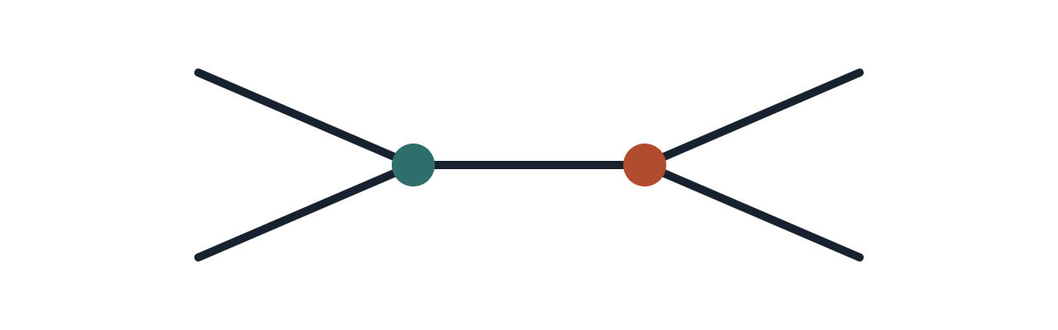
Price each change, then try every assignment
A
C
Total cost of the whole tree, for every pair of bases you could put at u and v
total | v = A | v = C | v = G | v = T
u = A | 10 | 6 | 11 | 6
u = C | 25 | 11 | 25 | 12
u = G | 13 | 8 | 12 | 8
u = T | 25 | 12 | 25 | 11
A
node u
node v
T
Cost of one change
from / to | A | C | G | T
A | 0 | 5 | 1 | 5
C | 5 | 0 | 5 | 1
G | 1 | 5 | 0 | 5
T | 5 | 1 | 5 | 0
One cell, read out: u = G, v = C costs 1 + 1 for the two A→G transitions, 5 for G→C across the middle, 0 for C→C and 1 for C→T. Total 8.
The smallest total is 6, at u = A with v = C or v = T. Score the same site with every change costing one and you get 2 — and the ranking of the three topologies can come out differently.
Teal 1 = transition, orange 5 = transversion, as in the lecture.
Notes:
Say what the right-hand table is before anything else: sixteen ways to fill in the two unknown ancestral bases, and the total cost of the tree under each. The tips are fixed; only u and v are free. Then note that Sankoff's algorithm does not actually enumerate all sixteen; it carries a vector of four best-costs up the tree, which is the same trick as Fitch but with numbers instead of sets. Sixteen cells is just how you see it by hand.

Slide 13
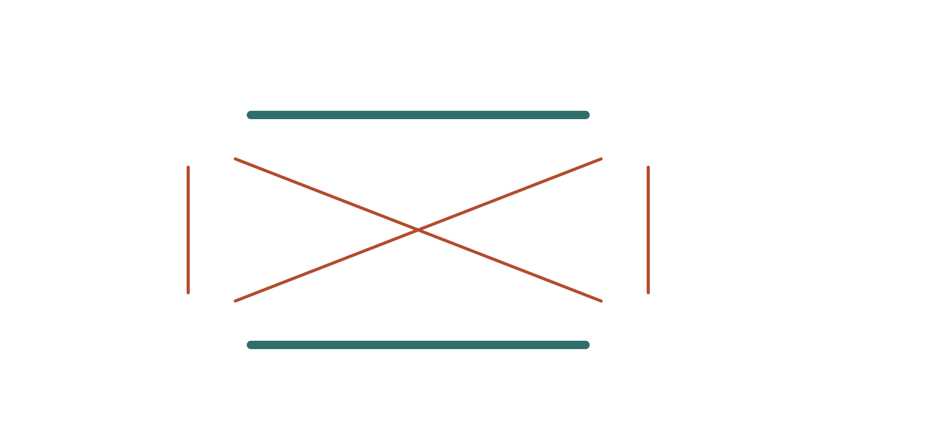
THE PROBLEM WITH COUNTING STEPS
Not every change is equally surprising
Transitions swap a purine for a purine, or a pyrimidine for a pyrimidine. Chemically similar, and in a coding sequence far more likely to be synonymous.
transition
A
G
purines
transversions
Transversions cross the two classes. There are twice as many ways to make one — and yet in most real alignments they are observed less often.
C
T
pyrimidines
transition
So two sequences sharing a transversion is stronger evidence of common ancestry than two sharing a transition. Unweighted parsimony ignores this entirely: both are one step.
Notes:
The intuition to hand them: rare events are informative, common events are cheap. If two people both own a car that tells you little; if both own the same rare first edition, they probably got it from the same place. Transitions are cars. This is also why transversion-only analyses were once used for deep divergences - at that depth transitions have saturated and carry nothing but noise.

Slide 14
Same alignment, two scores, different tree
site | 1 | 2 | 3
I | A | A | C
II | A | A | A
III | G | G | C
IV | G | G | A
Sites 1 and 2 split the taxa A A | G G, which favours Tree A. A to G is a transition — cheap and common, so weak evidence.
Site 3 splits them C A | C A, which favours Tree B. C to A is a transversion — expensive and rare, so strong evidence.
Trees as before: A = (I,II)(III,IV) · B = (I,III)(II,IV) · C = (I,IV)(II,III)
Basic parsimony — every change costs 1
Weighted — transition 1, transversion 5
site | Tree A | Tree B | Tree C
1 | 1 | 2 | 2
2 | 1 | 2 | 2
3 | 2 | 1 | 2
total | 4 | 5 | 6
site | Tree A | Tree B | Tree C
1 | 1 | 2 | 2
2 | 1 | 2 | 2
3 | 10 | 5 | 10
total | 12 | 9 | 14
Tree A wins, 4 steps. Two sites beat one, and that is the whole argument.
Tree B wins, cost 9. One transversion is worth more than both transitions together.
Same four taxa, same three sites, same three trees. The only thing that changed is the price list — and with it, the answer.
Notes:
This is the slide to make them check by hand. Site 3 on Tree A: whatever you put at the two internal nodes you are stuck with transversions, and the cheapest reading costs 10; on Tree B you put C at one node and A at the other and pay a single transversion, 5. Sites 1 and 2 are a straight A-to-G transition either way, so weighting barely moves them. The honest warning to give with it: the flip is real, but it is only as good as the cost matrix, and you chose that yourself before you looked at the data. Work out where the flip happens: with a transversion costing k, Tree A scores 2 + 2k and Tree B scores 4 + k, so they tie at k = 2, Tree A wins below it and Tree B above. The threshold is that low, the ratio is doing all the work, and nothing in this analysis tests whether the ratio you chose is right.

Slide 15
PART THREE
Rooting the tree of life, with nothing outside it to hold on to
Every tree you have rooted this term used an outgroup. Here there is none — so the outgroup has to come from inside, and part one already told you where to find it.
Notes:
Set up the puzzle before giving the answer. Ask them directly: how would you root a tree that contains every living thing? Let them try outgroups for a minute and hit the wall themselves. The answer is much more satisfying if they have felt the problem.

Slide 16
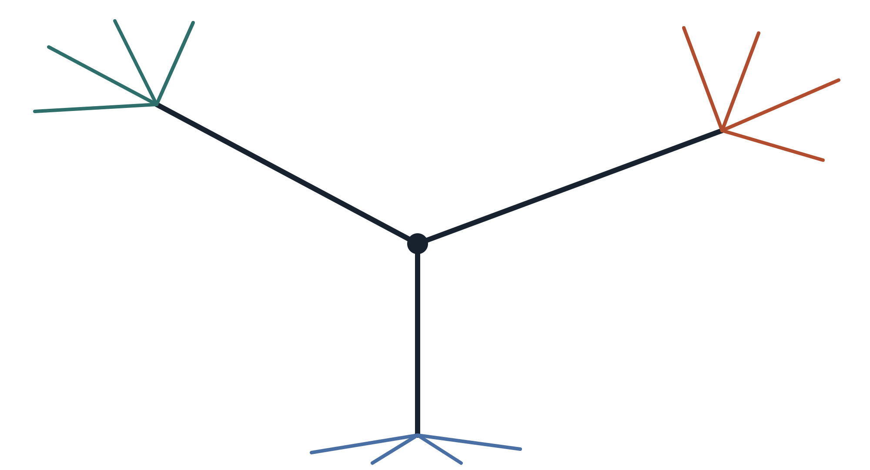
WHAT RIBOSOMAL RNA ACTUALLY GIVES YOU
Three domains, one connecting branch, and no direction
A universal alignment — ribosomal RNA, because every organism has it — recovers three deep groups joined at a single point.
The tree is unrooted. It tells you that the three domains are each other's relatives. It does not tell you which of them split off first, because it contains no statement about direction at all.
Eucarya
Bacteria
animals, plants, fungi
cyanobacteria, proteobacteria
Archaea
Everything people want from this tree — what the last common ancestor looked like, whether eukaryotes came from within the archaea — needs the root.
euryarchaeota, crenarchaeota
Notes:
Emphasise the drawing point: whenever they see this figure in a textbook it is drawn with a root, and the root is almost never justified by the figure itself. Ask them to say what the central node means on an unrooted tree - it is not an ancestor, it is just a point where three branches meet.

Slide 17
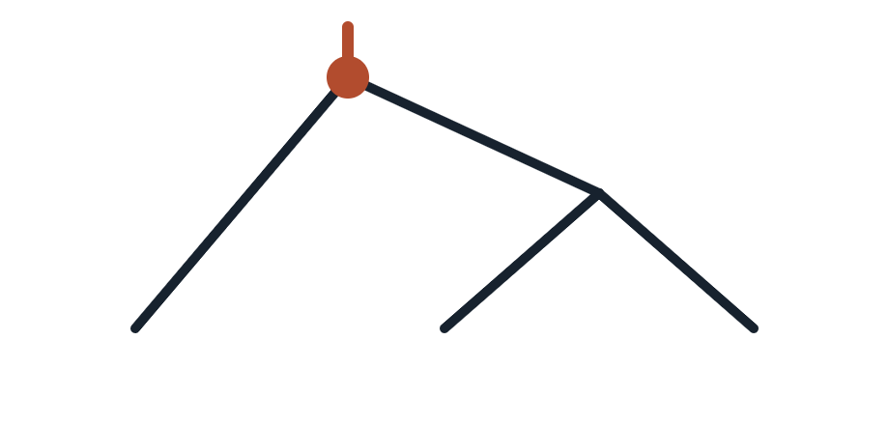
WHY YOU CANNOT JUST PICK ONE
Same unrooted tree, three different stories
Bacteria
Archaea
Eucarya
Archaea
Bacteria
Eucarya
Eucarya
Bacteria
Archaea
Root on the bacterial branch. Bacteria split off first, and Archaea and Eucarya are each other's closest relatives.
Root on the archaeal branch. Now Archaea split off first, and bacteria and ourselves are the close pair.
Root on the eukaryotic branch. Eucarya split off first — the story that flattered us for most of a century.
All three are the same unrooted tree. The alignment cannot choose between them, and the usual fix — add an outgroup — is not available: there is nothing alive outside life.
Notes:
Make them do the check: cover the root of each drawing and confirm that the three trees become identical. This is the same point as the R practical, where rerooting changed which groups were clades but left the unrooted topology alone. Here it changes the entire narrative of early evolution.

Slide 18
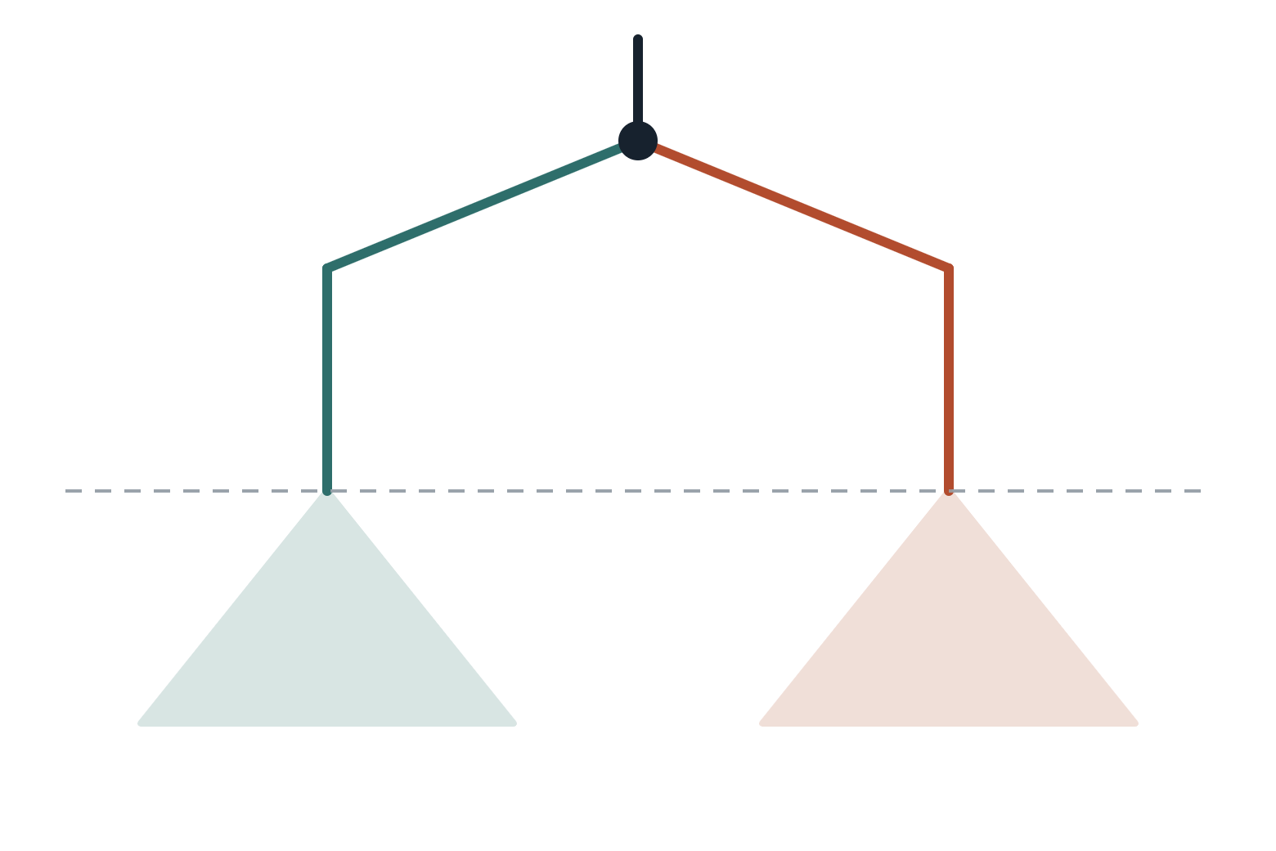
THE WAY OUT
Find a gene that duplicated before the last common ancestor
one ancient duplication
The duplication came first
Elongation factors EF-Tu and EF-G are both needed for translation, and every organism has both. The only way that happens is if the duplication happened before LUCA.
LUCA
So each copy has the same shape
Both families were carried down through every later split, so each one contains all three domains — two independent copies of the same history.
EF-Tu
EF-G
each triangle contains Bacteria, Archaea and Eucarya
And that gives you the outgroup. The EF-G family sits outside the EF-Tu family in time, so each family roots the other — without needing an organism from outside life.
Notes:
The ATPase alpha and beta subunits were used the same way and gave the same answer, which matters because it is an independent gene pair. Iwabe and colleagues published the elongation factor version in 1989. If anyone asks how we know the duplication predates LUCA rather than being an early lateral transfer, the answer is the tree shape itself: if it were later, one or more domains would be missing a copy.

Slide 19
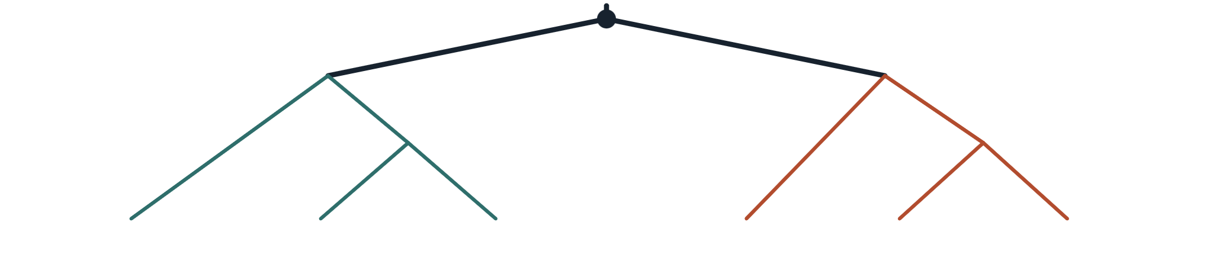
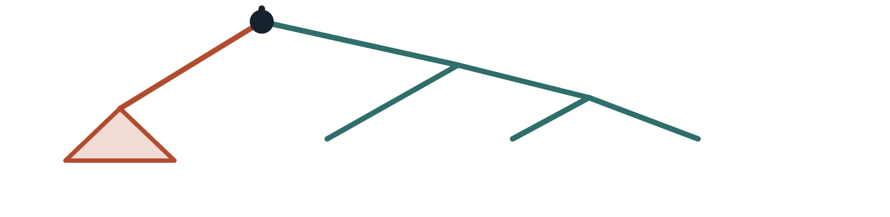
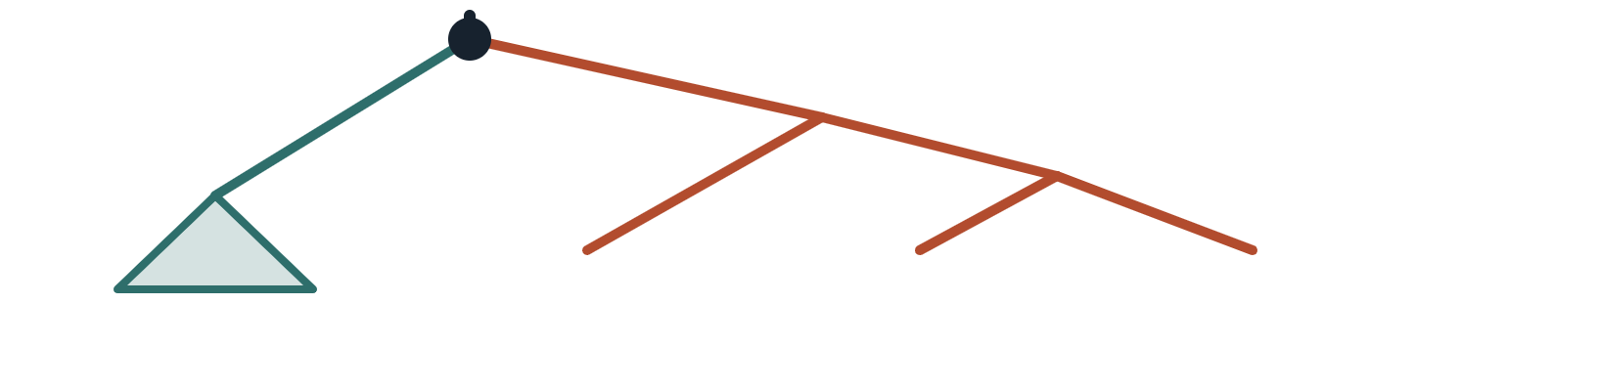
Analyse both copies together and the tree roots itself
The deepest split is the duplication — older than every speciation on this tree, which is exactly what an outgroup has to be.
Bacteria
Archaea
Eucarya
Bacteria
Archaea
Eucarya
EF-Tu family
EF-G family
Read the EF-Tu half: the EF-G sequences sit outside it, and they put the root on the bacterial branch.
Now read the EF-G half: the EF-Tu sequences are outside it, and they put the root in the same place.
root
root
EF-G
Bacteria
Archaea
Eucarya
EF-Tu
Bacteria
Archaea
Eucarya
Notes:
The two small trees are the same big tree, read twice: each time one family is collapsed to a triangle and used as the outgroup for the other. The move to make explicit is that we converted an unrootable problem into two ordinary rooted analyses by doubling the data. It only works because the duplication is older than every split we care about - which is the general rule, and the reason this method is used inside gene families all the time, not only for the tree of life. Both readings agreeing is the point: one alignment, two independent roots, same answer.

Slide 20
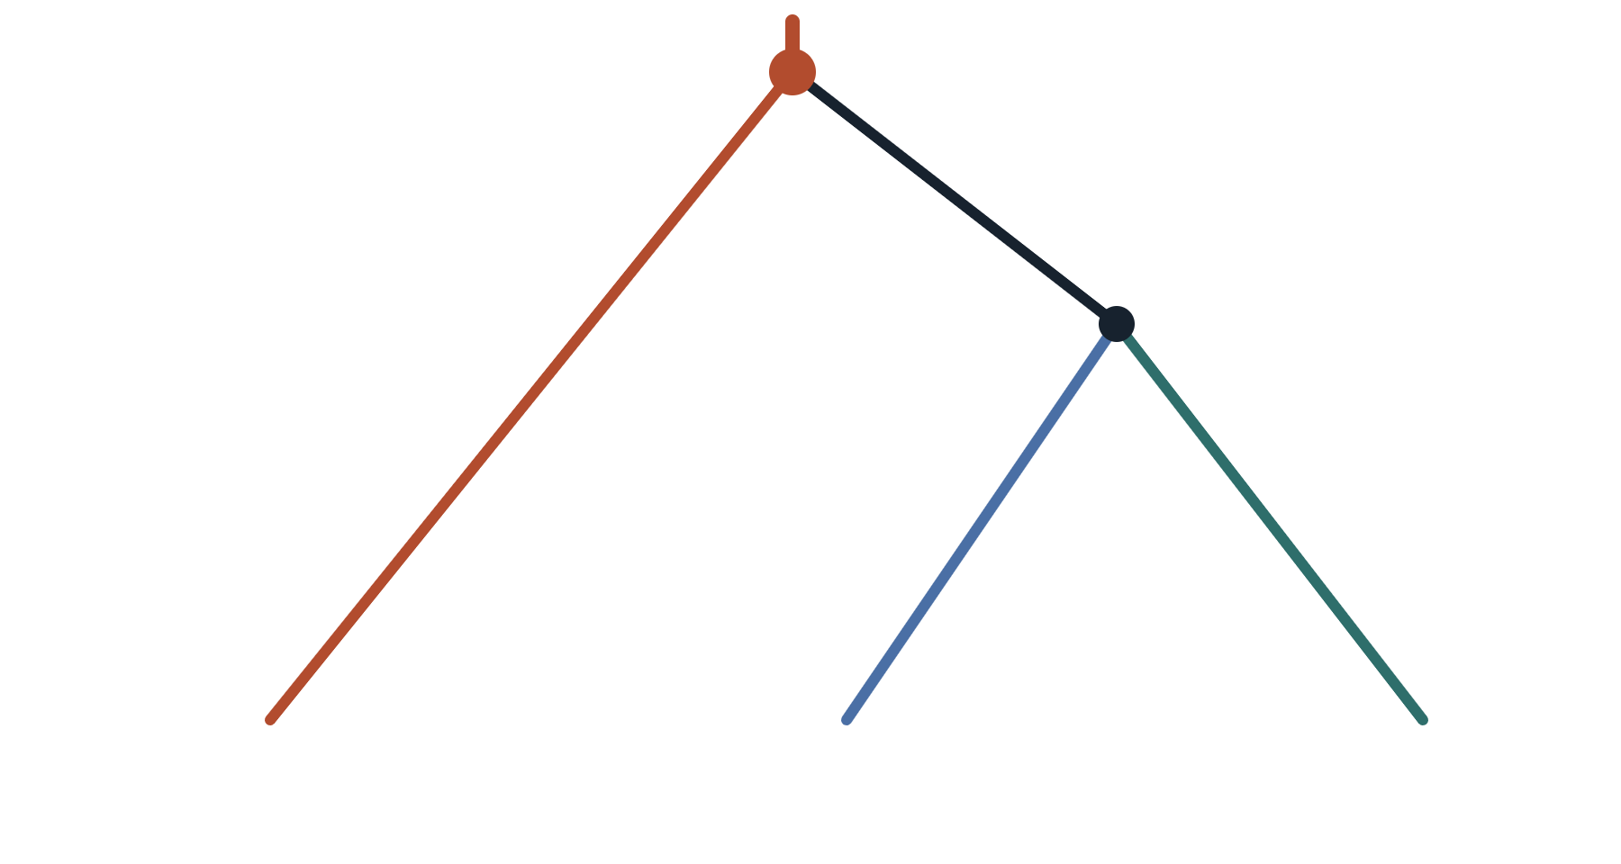
THE ANSWER
The root sits on the bacterial branch
root, placed by the EF-Tu / EF-G comparison
Archaea and Eucarya are sisters. We are more closely related to a thermophilic archaeon than either of us is to E. coli.
sister groups
Now every branch has a direction. You can say which state is ancestral and which derived, polarise a character change, and ask what LUCA already had.
Bacteria
Archaea
Eucarya
And the whole thing rests on a gene duplication — the same event that in part one was mostly a way to get your dates wrong.
Notes:
Worth saying that this is the classic result and that the picture has since become more complicated: several analyses place eukaryotes within the archaea rather than as their sister group, which would make Archaea paraphyletic. That does not undermine the method - it is still the rooting logic everyone uses - but it is a live question, and a good one to end on if anyone is interested.

